Slide 1
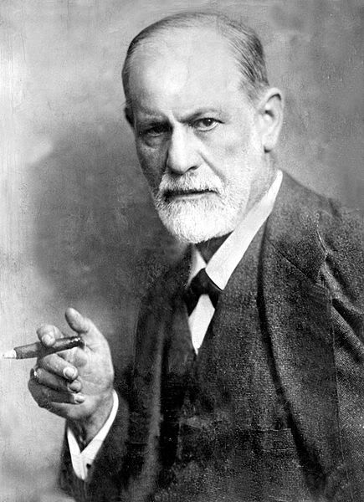
Psychoanalytic Criticism
Ashley Burkart
English 274

Slide 2
Quick History
Sigmund Freud
Theorist and therapist
Before Freud-Aristotle and Plato
Two schools of Psychoanalytic Criticism
American Vs. French

Slide 3
4 Ways to analyze literature through a Psychoanalytic perspective
Unconscious
Sexuality, Repression, and Desire
Male and Female Identity
Realities and Consequences of Trauma

Slide 4
Dynamic Model & Economic Model
External realities vs. internal realities
Conscious vs. unconscious
Economic Model
Pleasure Principle vs. Reality Principle

Slide 5
Topographical Model
Part 1
Part 2
Three divisions of mind
Conscious
Subconscious
preconscious
Three Divisions of Mind
Id
Ego
Superego

Slide 6
Let’s Review…
http://www.youtube.com/watch?v=6a8mwidjG8s&feature=related

Slide 7
Oedipus Stage
Focal point
Repression
Sexual desires
Sexual identity

Slide 8
Castration Complex
Repression
Socially Acceptable thoughts
Identify with Father’s social Norms
Masculine vs. Feminine

Slide 9
History/Review of King Lear
When it was written
Between 1603 and 1606
What it was based off of
Legend of Leir of Britain
What the audience reaction was

Slide 10
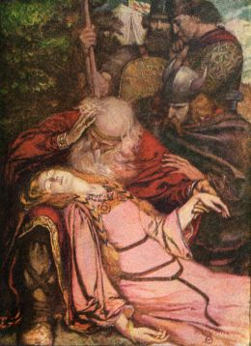
Murray M. Schwartz and King Lear
Oedipal Complex
“Which of you shall we say doth love us most?” (I.i.50)
Castration Complex
Death of Cordelia
loss of incest bond

Slide 11
Richard P. Wheeler and King Lear
Oedipal Complex
“I loved her most, and thought to set my rest/On her kind nursery…” (I.i.39;123-124).
Loss of “True Need”
Realization of Cordelia’s death
“Thou’lt come no more/Never, never, never, never…” (V.iii.308-309).
Longing to exist in her presence
“Look on her! Look her lips/look there, look there…” (V.iii.311-312).

Slide 12
Peter L. Rudnytsky and King Lear
Oedipal Complex
Maintain incestuous bond with Cordelia
Introductory Scene-professing love
Castration Complex
Fool and King Lear
“I am a fool, thou art nothing” (1.4.200-202)
Edmund
Bastard child and womanizer
Death of Goneril and Regan

Slide 13
History/Review of Romeo and Juliet
When it was written
Between 1594 and 1596
What it was based off of
Tragicall Historye of Romeus and Juliet
What the audience reaction was

Slide 14
Madelon Gohlke and Romeo and Juliet
Formation of Identity
“the weaker vessels are ever thrust to the wall” (I.i.17-18).
Economic Model
Pleasure Principle Vs. Reality Principle
Topographical Model
Conscious Vs. Unconscious
Superego Vs. Id

Slide 15
Some questions to keep in mind…
According to Freud, how do the id, ego, and superego come together to form the psyche?
What are the 4 ways to psychoanalyze literature through a psychoanalytic perspective?
What is the oedipal complex? How can it be applied to such literary works as King Lear and Romeo and Juliet? What are the signifiers that allow the reader to know to analyze through a psychoanalytic perspective?
What are the three Freudian models? How can they be applied to different literary works? What are the signifiers that allow the reader to know to analyze through a psychoanalytic perspective?
What is the castration complex? How can this complex be applied to different literary works? What are the signifiers that allow the reader to know to analyze through a psychoanalytic perspective?

Slide 16
Here’s some hints…
Youtube Clip
http://www.youtube.com/watch?v=6a8mwidjG8s&feature=related
Psychoanalytic Theory Explained
<http://www.purdue.edu/guidetotheory/psychoanalysis/psychterms.html>.

Slide 17
Questions from the audience?

Slide 18
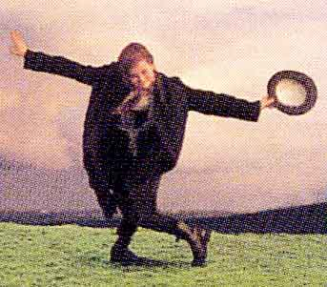
I bid thee a fair adieu !

